Slide 1
HOCKEY ANALYTICS PRIMER
SIHR USA East Chapter Meeting
HOCKEY ANALYTICS PRIMER
Twitter: @LukeDonoho
E: Luke.Donoho@gmail.com

Slide 2

Hockey Analytics, You say?

Slide 3
Common Terms & Concepts
Corsi for possession
PDO As Luck
Score Adjusted Possession
Relative Statistics & WOWY
Goaltending AKA Voodoo
Rob Vollman’s Player Usage Charts

Slide 4
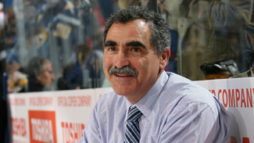
Corsi
Possession based statistics
Corsi

Slide 5
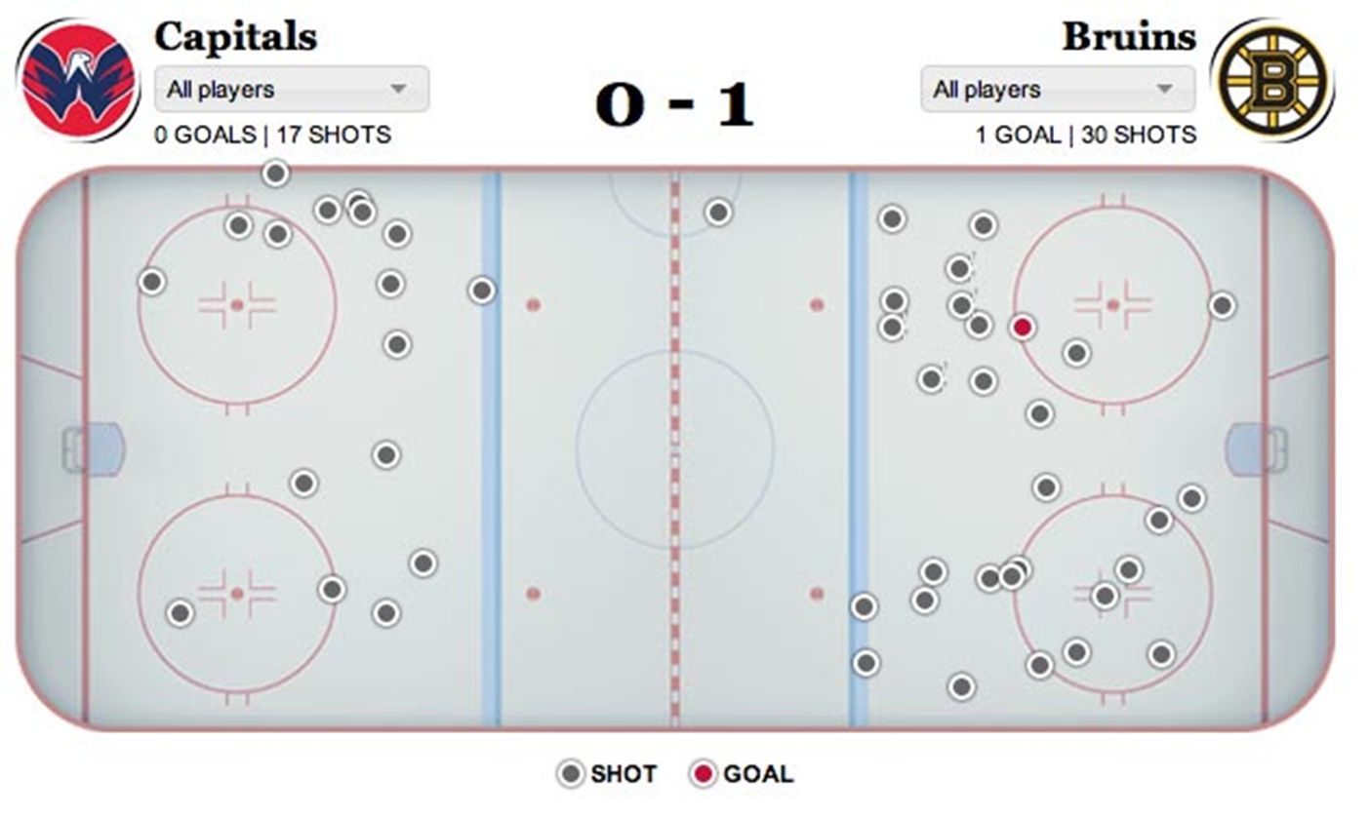
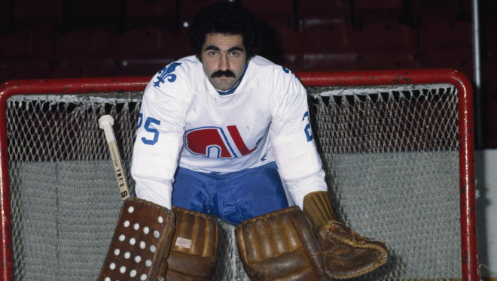
Corsi
Shot counting
Puck possession proxy based statistics
Corsi:
Shots On Goal + Missed Shots + Blocked Shots

Slide 6
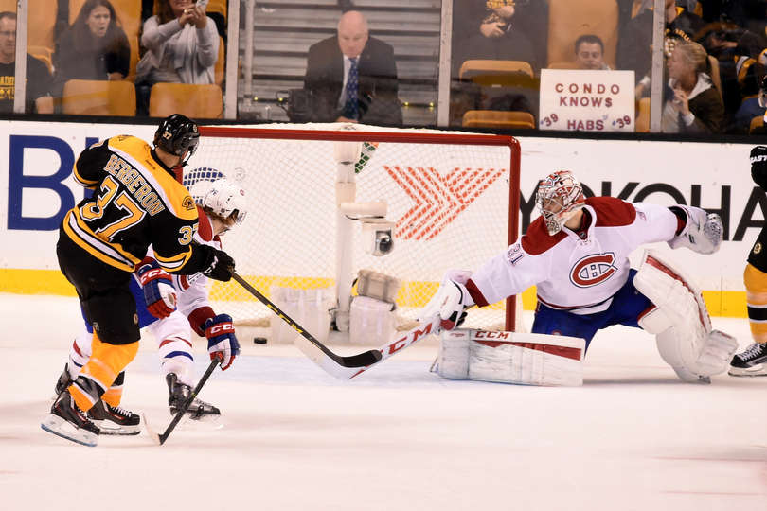
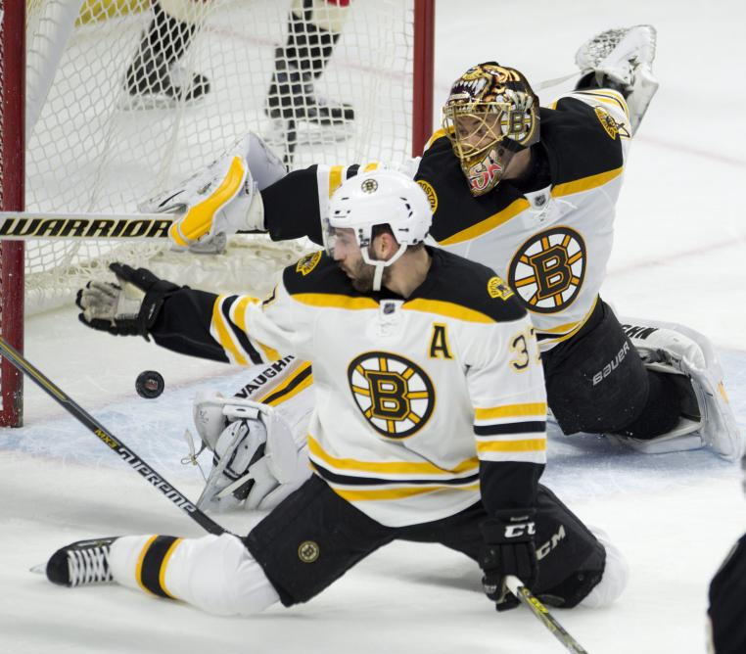
Corsi
Shots On Goal + Missed Shots + Blocked Shots
Bergeron is on the ice for 15 Bruins shots in a game
Habs take 8 shots while he is on the ice in the game.
Corsi For (CF) = 15
Corsi Against (CA) = 8
Bergeron is a +7 Corsi in the game (15 – 8 = 7)
Player | CF | CA | CF% | CA%
Bergeron | 15 | 8 | 65% | 35%

Slide 7
Relative Stats & WOWYs
CorsiOn
ON
Total number of ‘Corsi events’ when player is playing
X
Number of minutes in a hockey game (60)
÷
Time On Ice of Player (TOI)
Corsi ON = (Total Corsi Number) x (60) / TOI
CorsiREL
Corsi REL = Corsi ON - Corsi OFF
Bergeron 8.2 (at time of writing)
WOWY
http://www.puckalytics.com/superwowy.html

Slide 8
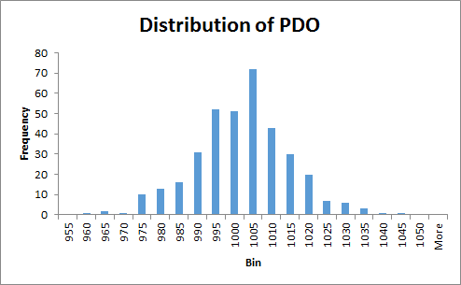
PDO
PDO Formula
PDO - Shooting percentage (SH%) + Save Percentage (SV%)

Slide 9
PDO
No Goals
Good Luck
Bad Luck
Goals For Everyone
League Averages*
Shooting %: 7.35% Save % : 92.6%
Avg 5v5
through 3/4/2016
95%
Save %
(Sv%)
90%
Shooting %
(Sh%)
5%
10%

Slide 10
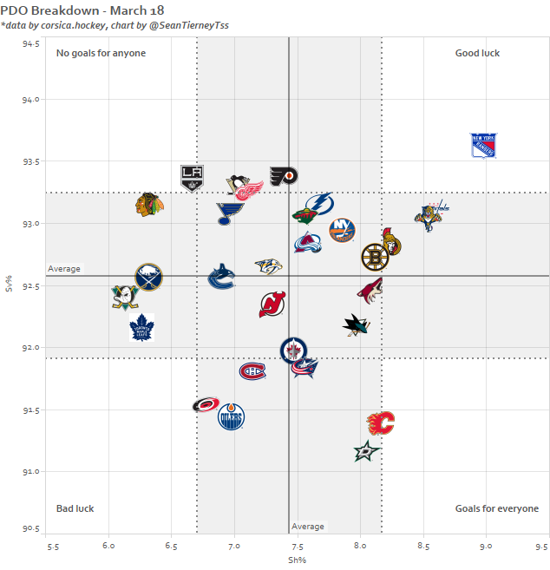
PDO

Slide 11
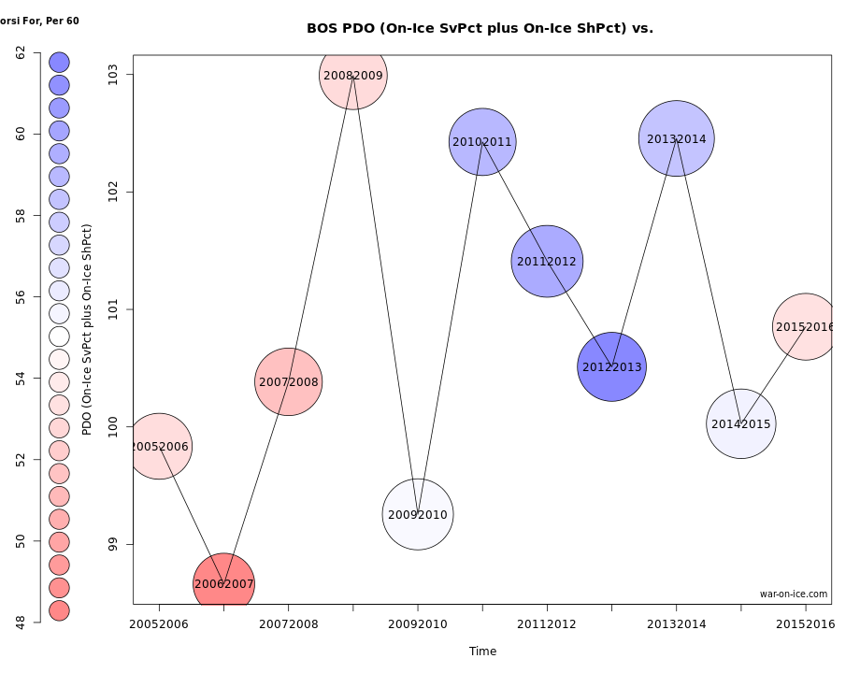
PDO

Slide 12
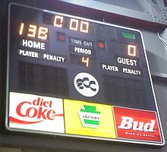
Score Effects & Adjustments

Slide 13
Score Effects & Adjustments
Score Adjusted Possession
8.46 * (Fenwick Up 1 - 46.1%)
8.46 * (Fenwick Down 1- 53.9%)
3.75 * (Fenwick Up 2 -44%)
3.75 * (Fenwick Down 2 - 56%)
42.36 + 50%
17.94 * (Fenwick Tied - 50%)
÷
+
+
+
+

Slide 14
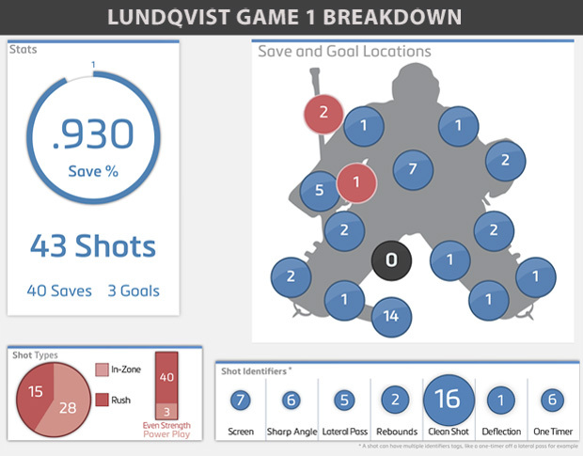
Goaltending

Slide 15
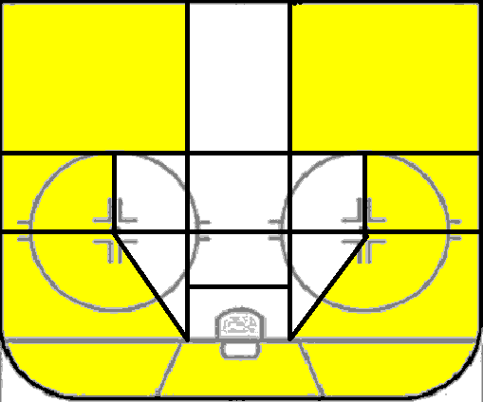
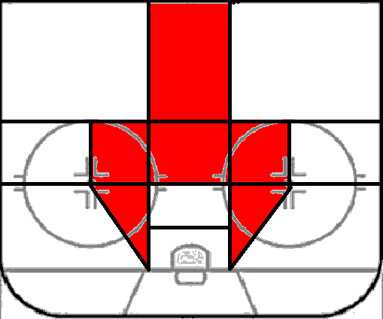
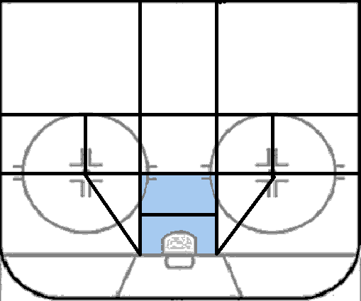
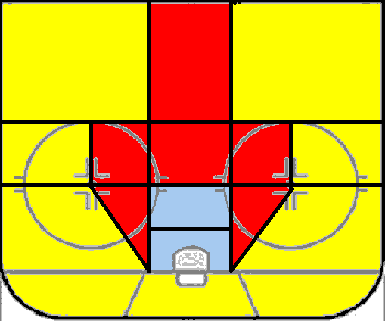
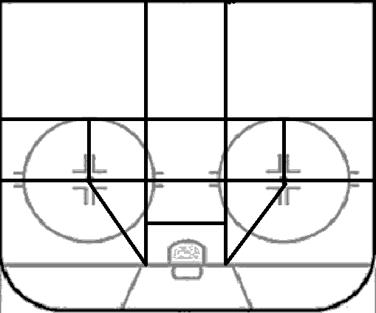
Goaltending

Slide 16
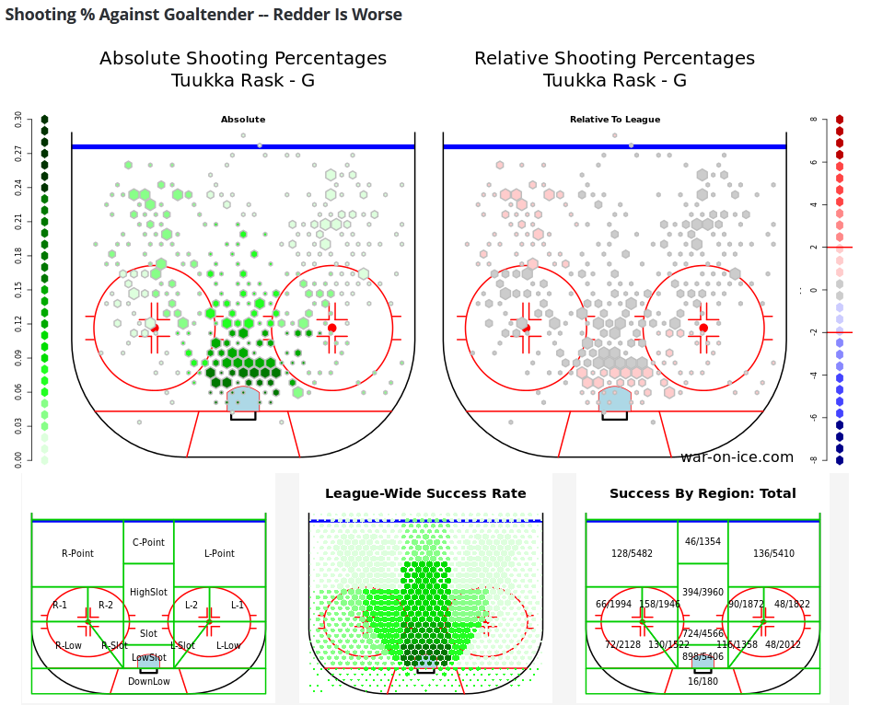
Goaltending

Slide 17




Player Usage Charts
Rob Vollman
“Bill James” of Hockey Analytics
http://www.hockeyabstract.com/playerusagecharts

Slide 18
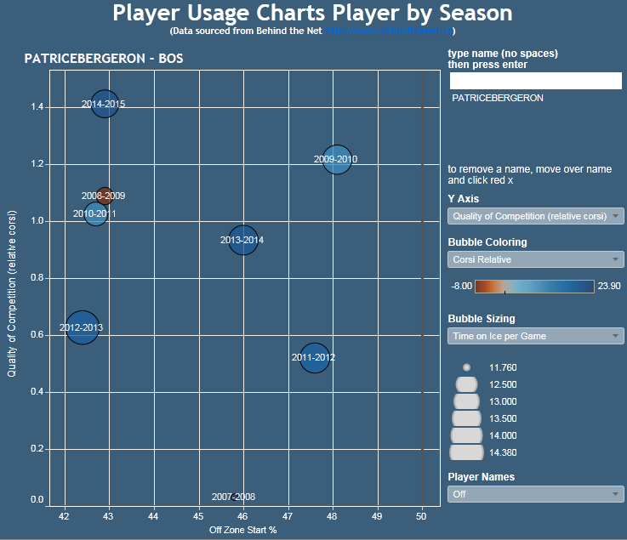
Player Usage Charts

Slide 19
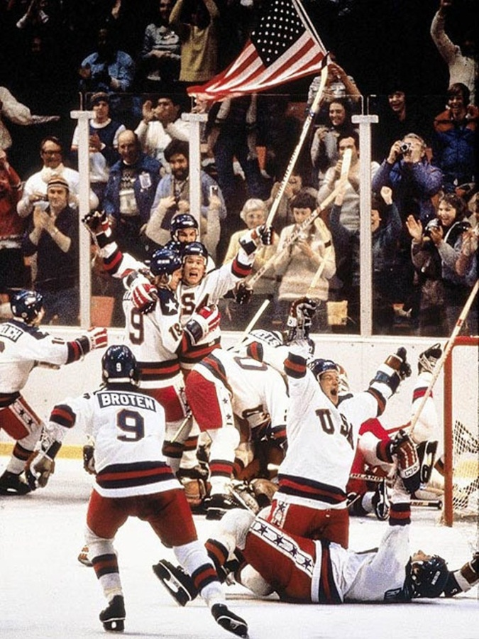
Analytics answer everything?
Game | Team A | Team B
1st | 8 | 18
2nd | 2 | 12
3rd | 6 | 9
Total | 16 | 39
Score | Time
+1 | 10:00
Tied | 15:23
-1 | 33:37:00

Slide 20
References & Links
Awesome Links
http://stats.hockeyanalysis.com
https://hockey-graphs.com/about/
www.todaysslapshot.com/
https://jenlc13.wordpress.com/
http://www.hockeyprospectus.com/
http://www.secondcityhockey.com/2013/12/4/5167404/nhl-stats-made-simple-part-1-corsi-fenwick
http://www.habseyesontheprize.com/2013/7/16/4529774/fancy-stat-summer-school
http://war-on-ice.com
http://deathbyleafs.blogspot.ca/2014/04/what-do-possession-stats-get-you.html
http://www.hockeyabstract.com/playerusagecharts
http://www.corsica.hockey/

Slide 21
References & Links
References
Corsi, CorsiRelative, WOWY
http://www.secondcityhockey.com/2013/12/11/5201286/how-i-stopped-worrying-and-learned-to-love-fancy-stats
https://www.nhl.com/news/shot-charts-tell-a-story-for-ovis-exit-sids-next-round/c-527735
http://www.sloansportsconference.com/?p=8818
https://mapleleafshotstove.com/2014/09/29/wowys/
https://mapleleafshotstove.com/2014/08/05/introduction-to-advanced-statistics/
PDO
http://www.sportingcharts.com/nhl/stats/team-pdo-numbers-save-plus-shooting-percentage/2015/
http://www.pensionplanpuppets.com/2015/1/21/7863291/a-primer-pdo-and-normal-distributions
https://public.tableau.com/profile/sean.tierney#!/
Score Effects / Score Adjustments
http://www.hockeyprospectus.com/parnass-playoff-series-score-effects-and-the-power-of-loss-aversion/
https://hockey-graphs.com/2014/11/13/adjusted-possession-measures/ http://www.hockeyprospectus.com/burtch-value-of-5v5-score-close-vs-score-adjusted-metrics-for-prediction/
Goaltending : http://ingoalmag.com/analysis/its-time-to-scrap-goals-against-average/
Vollman: http://www.hockeyabstract.com/playerusagecharts
http://www.arcticicehockey.com/2010/2/28/1330251/shot-totals-in-1980-us-ussr-game

